Slide 1

Automobile price prediction
A CRISP-DM data mining process
By:
Daniel Falcone
Truc Huynh
Hikma Abajorga
Notes:
Good afternoon! In this presentation a data mining approach following the CRISP-DM industry standard is leveraged in order to predict automobile prices.

Slide 2
Contents
Introduction
Methodology
Results & Discussion
Managerial Implications
Conclusions
Notes:
During the talk, the following main points will be discussed: the introduction which consists of the motivation for writing the report and background research, the methodology section, including the CRISP-DM framework, the variables used and machine learning methods employed. Then, the results and performances of the models are discussed, including feature performance analysis. Finally, important managerial implications are mentioned and a conclusion is drawn.

Slide 3
Motivation
Providing quick and affordable price advice to potential car buyers.
Assisting in second hand automobile pricing decisions.
Diminishing dependence on specific mechanical expertise.
Odometer fraud detection.
Enhancing already existing models.
Determining the most important variables.
Notes:
Automobile price prediction is especially important in the case of used vehicles. Correctly predicting car prices traditionally involves expert knowledge, as the price depends on many distinct factors, such as engine specifications, horse power, speed, acceleration, brand, safety, aspect, and many others. Cost prediction has the potential of aiding both potential car customers in paying a fair price for their new auto-vehicle, but can also enhance second hand car retail price decision processes. The fact that the model does not include mileage allows it to pick up on other relevant variables and provides a valuable potential to enhance already existing models.
Another area of interest in which the model could thrive, which is unexplored by previous papers, is odometer fraud detection. In 2002, in the US, it was estimated that 3.5% of vehicles have had their odometer tampered with at some point during their life time, and that economical costs were reaching 1$ billion dollars/year.

Slide 4
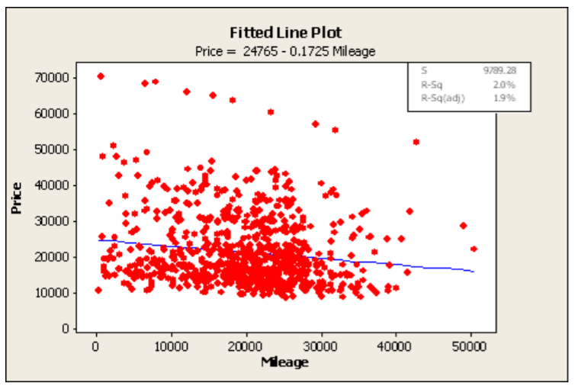
Literature Review
Random Forests model on 370,000 vehicles achieved 83.63% R² score, revealing the most important features: kilometres, brand, vehicle type (Paul et al., 2018)
Kuiper (2008) analysed 800 GM cars and achieved 91 R². The importance of using multiple variables such as cruise control and leather is emphasised
Reference: Kuiper, S. (2008). Introduction to Multiple Regression: How Much Is Your Car Worth?. Journal of Statistics Education, 16(3).
Notes:
Research in car price prediction is relatively limited. Previous studies analysed datasets of varying sizes from many countries, such as Germany, China, USA, Mauritius and Bosnia and Herzegovina. Some scientists, especially those who accessed large datasets, such as Paul et al., 2018, who analyse a set comprising 370,000 vehicles, used regression methods and scored their models on R squared. By using the Random Forests model, which is an ensemble technique built on top of multiple Decision Trees, which are discussed later on in the presentation, a 83.63 R squared score was achieved. The most important features were kilometre on board, brand, and vehicle type
The image on the slide is from a study by Kuiper in 2008, which demonstrates the importance of using multiple features in a car cost prediction linear model, by analysing 800 General Motors cars. Furthermore, by utilising multiple relevant variables such as cruise control and leather, a score of 91 R squared was attained.
Other scientists categorised the price in order to fit classification models, a method which is employed in this report. Muley (2017) used Decision Trees and regularised Linear Regression in his master’s thesis, finding that horsepower was the feature most strongly positively correlated with price

Slide 5
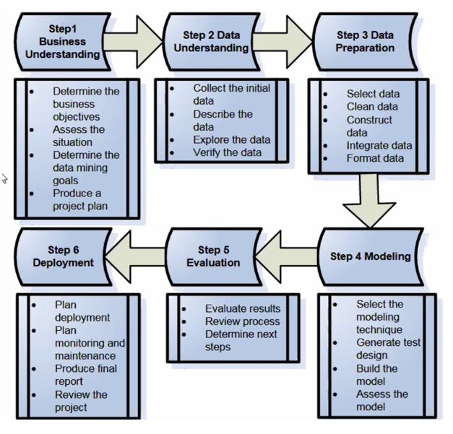
CRISP-DM
Cross-Industry Standard Process for Data Mining.
Provides a framework for data mining which ensures smooth progression
Benefits efficient data organisation for business processes.
Notes:
CRISP-DM, short for Cross-Industry Standard Process for Data Mining is the framework followed in this report. It ensures smooth progression between steps plus efficient data mining and data organisation for improving the quality of business processes. As the image shows, it consists of 6 steps:
Step 1 is understanding the business objectives and producing a project plan
Step 2 consists of collecting describing, exploring and verifying data
Step 3 is data preparation: data selection, cleaning and formatting
Step 4 represents selecting the modelling technique, as well as building and assessing the model
The fifth step is the result’s evaluation, reviewing processes and determining the next steps
Lastly, step 6 consists of the plan deployment, report review and ongoing activities such as plan monitoring and maintenance.

Slide 6
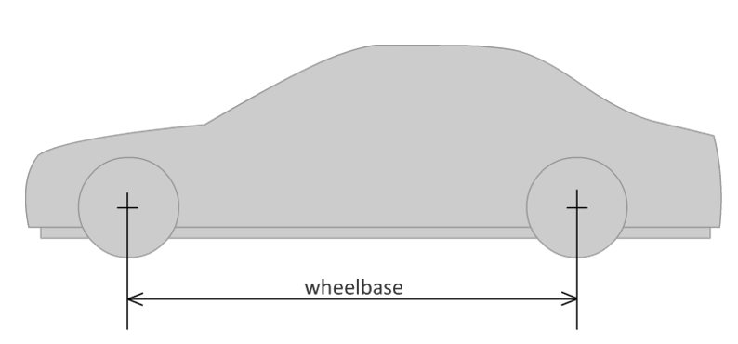
Variables 1
205 cars, 26 variables
4 variables lacked price data -> n=201
Make
Fuel Type
Drive wheel
Engine location
Wheelbase
Length
Notes:
Some of the variables expected to have an impact on the price are make, which is the car manufacturer and was shown to be an important predictor by some previous researchers, fuel type (either diesel or gas) and drive wheel (how the power is transferred to the wheels, can be front wheel drive, rear wheel drive or 4 wheel drive). Other important features are the engine location, either at the back or at the front, the wheelbase, which as the image shows, is the distance between front and rear wheels, and the total length of the car.

Slide 7
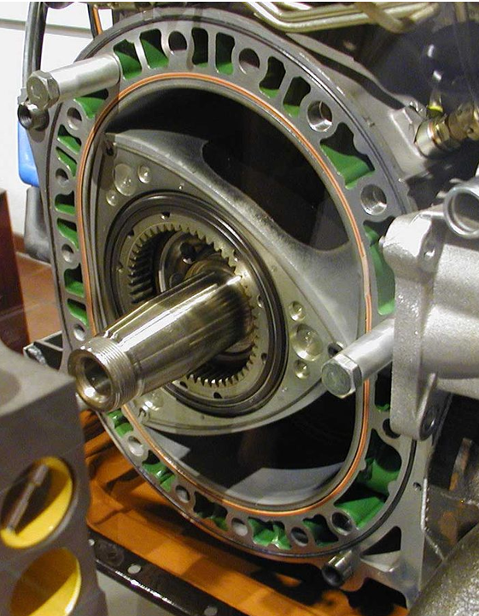
Variables 2
Curb-weight
Engine type (Wankel rotary in the image)
Engine size
Fuel system
Number of cylinders
Notes:
Furthermore, significant variables may include curb-weight, which the total weight of the operational vehicle which includes fuel and oil weight; engine type, such as the older rotary engine, like the one in the shown photo, engine size, fuel system and number of cylinders. As the engine is the most important piece in a car, it’s specifications are expected to have a significant impact on price.

Slide 8
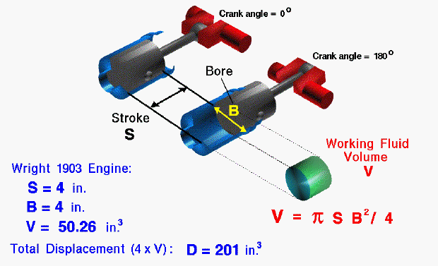
Variables 3
Bore and stroke
Horsepower (hp)
Fuel consumption in the city (city mpg)
Notes:
Bore represents the inner diameter of the engine cylinder, a wider one usually meaning more air and fuel can be brought into the cylinder, therefore achieving more power. The stroke, as shown by the illustration, is the distance that the piston travels within the cylinder. A longer stroke determines more fuel consumption efficiency as it reduces surface area during combustion. Important engine components are expected to significantly impact the price.

Slide 9
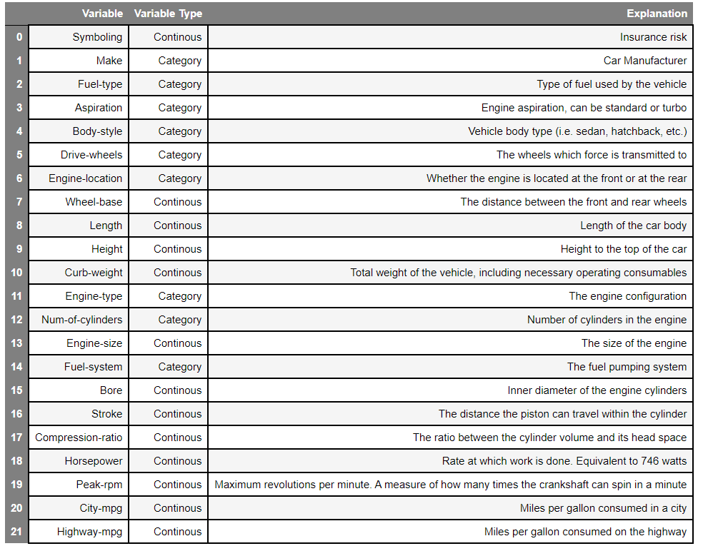
Variables Table
Notes:
Not all of the available variables were considered in the final models As the table suggests, normalized losses, number of doors, and width were dropped, as they are not expected to affect the price. Sensitivity analysis will confirm which of the variables are the strongest automobile cost predictors.
Price ranges between 5,118 and 45,400 dollars. In order to employ classification models and improve accuracy, the price is categorised into 3 roughly equally split groups: less than $8,249, between $8,249 and $13,645 and $13,645+. The categories have 68 samples, 67, and 66 respectively. Relative to one another, these categories will be called “cheap”, being the least expensive among the cars in this dataset, averagely-priced and the ones who are priced highest in this dataset are termed “expensive”.
Data was processed and modelled using the Python programming language. The libraries utilised for data cleaning and analysis are: NumPy, which provides fast numerical computing tools, Pandas, a flexible data manipulation tool built on top of Numpy, and sklearn, short for scikit-learn, an open source data analysis tool which packages algorithms such as multi-layer perceptron neural networks, for easy and intuitive use. For plots, seaborn is chosen for its versatility and its compatibility with pandas and sklearn.

Slide 10
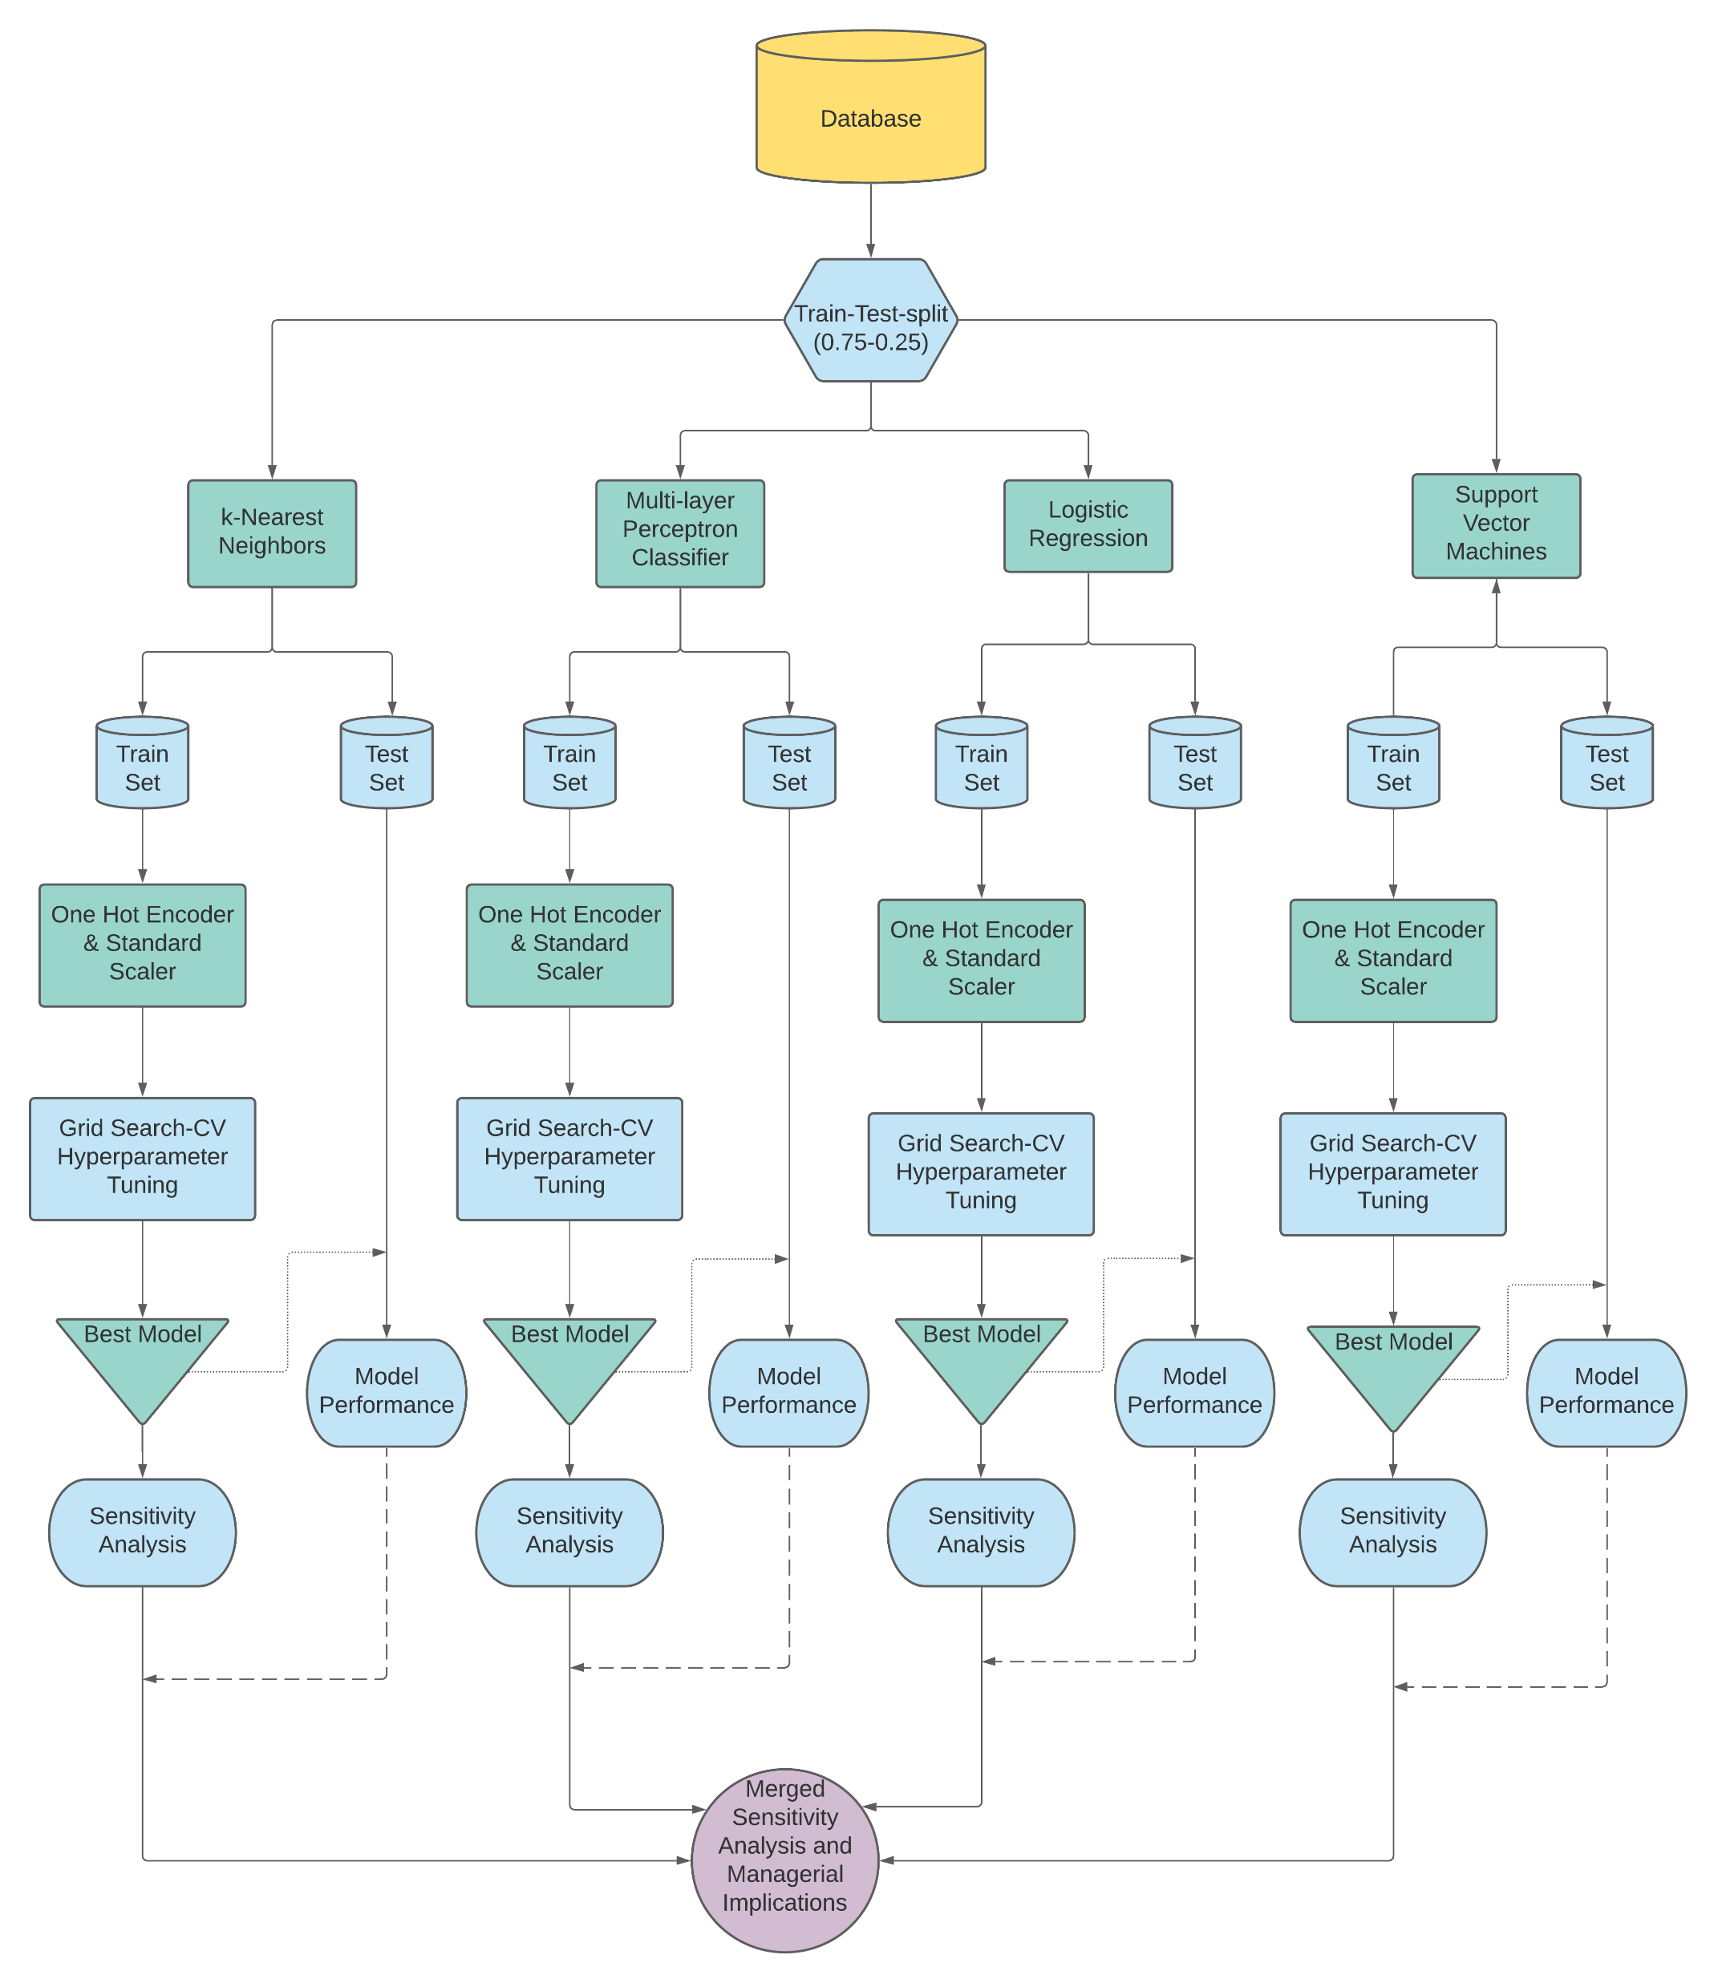
Data processing flow chart
One hot encoding
Min-Max Scaling
Train-test-split
Notes:
Before the data can be modelled, it has to be transformed in a format that a computer can understand.
Categorical data is stored in an object format, which cannot be interpreted by Python. One hot encoding transforms a categorical variable into a series of columns, each representative of an individual value, containing binary values (0 or 1) which represent whether the car belongs to that class or not. For continuous data, minMax Scaling is used, which projects all values to a range between 0 and 1 and prevents features with large scale values such as rpm over-impacting the model.
The dataset is also split between training and testing sets. The train set is used for fitting the model to it, while the test set’s purpose is to assess the performance of the models. If performance was to be assessed on training data, overfitting would be risked, which consists mainly of the model incorporating noise into it’s decision making process.

Slide 11
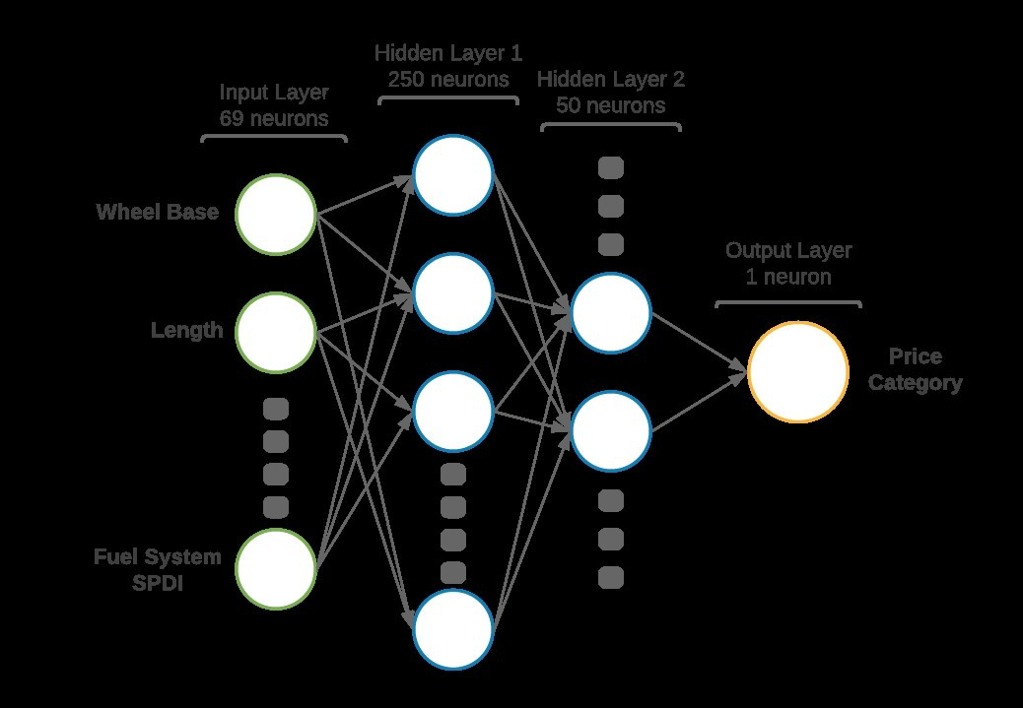
Data Mining Techniques
K-Nearest Neighbors
Multilayer Perceptron Classifier
Logistic Regression
Support Vector Machines
Notes:
Three machine learning models are employed in this report: k nearest neighbors, multilayer perceptron classifier, also known as artificial neural networks, logistic regression and Support vector machine.
Hyperparameter tuning is performed for all the models using grid search cross validation. It is a method of splitting data into a user-provided number of folds (three were given in this study). The folds are shuffled, each iteration one of them being the test set, and the other 2 the training set.
k-nearest neighbors, in short knn is a predictive analysis method in which a new data point is classified to be equal to the majority category between its k nearest neighbors, where k can be any whole number larger than 1.
The artificial neural network is constructed using multiple perceptrons, which are meant to mimic the human brain’s neuron. It takes in some inputs, each with a specific weight, it adds a bias to them and according to the result it gives an output. The output of each neuron feeds forward into the next layer, until the output layer is reached. Then, the result is compared to the true value and a log-loss score is computed. The model uses a method called stochastic gradient descent, whose specifications are beyond the scope of this presentation, to minimise the loss and therefore improve accuracy.
Logistic regression is a straightforward model that plots a logarithmic function to model a binary value. In order to predict multiple categories, an extension is used. Furthermore, a regularisation parameter is added to the function, to reduce complexity and prevent overfitting.
Support Vector Machines, or SVM, work by plotting a hyperplane to split data into different categories. Given any N-dimensional data, the hyperplanes will be N-1 in size. To use SVM for multiple classification, the SVM is kernelized in order to increase the number of dimensions of the input data space. Both Polynomial and Radial based Function kerneles are used in this analysis.

Slide 12
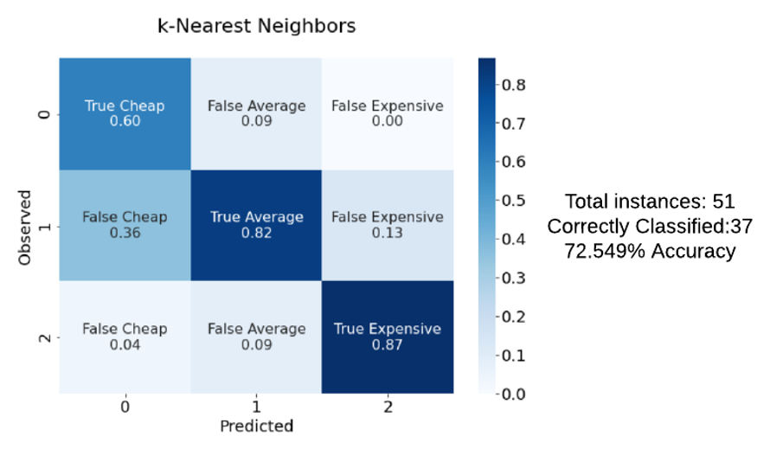
K-Nearest Neighbors Results
72.549% accuracy
37/51 correct predictions
93.75% cheap vehicles recall
45% average price recall
87% recall on expensive cars
Notes:
The first fitted model is kNN, which achieves 72.549% accuracy. Precision on cheap automobiles is only 60%, since it overestimates their count to be 25 instead of 16. The recall is however good, 93.75%. Nonetheless, sensitivity on averagely priced cars is very low, 45%. Recall and precision on expensive vehicles are both 87%.

Slide 13
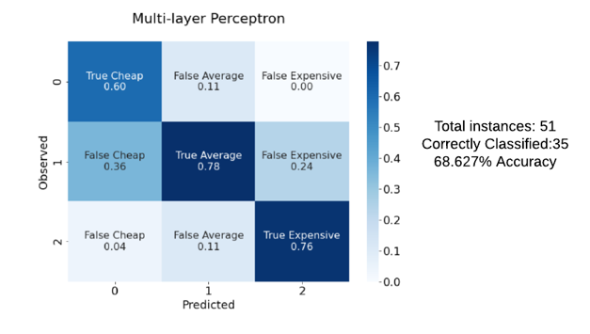
Multi-layer Perceptron Results
68.627% accuracy
35/51 correct predictions
93.75% cheap vehicles recall
35% average price recall
85% expensive cars recall
Notes:
Although the most complex model, the ANN performed the worst (68.627%), only 35 out of 51 instances being identified correctly. The model overestimates the number of cheap vehicles: 25, instead of 16. Only 15 of the cheap class predictions are accurate (60%). Although it corresponds to a high precision, 93.75%, 9 cheap predictions incorrectly classify average price, and 1, expensive.
78% precision on expensive vehicles is noted, however only 35% on averagely priced ones, barely better than a random guess.

Slide 14
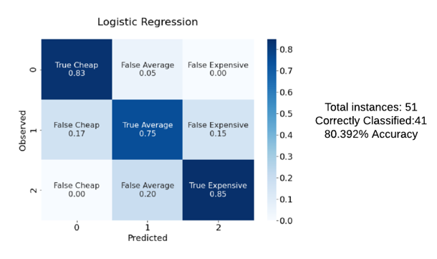
Logistic Regression Results
41 out of 51 correct predictions
93.75% recall on cheap vehicles
75% on averagely priced cars
85% recall on expensive automobiles
Notes:
The logistic regression algorithm correctly predicts 41 out of the 51 automobile price categories, achieving an accuracy of 80.392%. A 93.75% recall is achieved on cheap vehicles, 75% on averagely priced ones, and 85% on expensive automobiles.

Slide 15
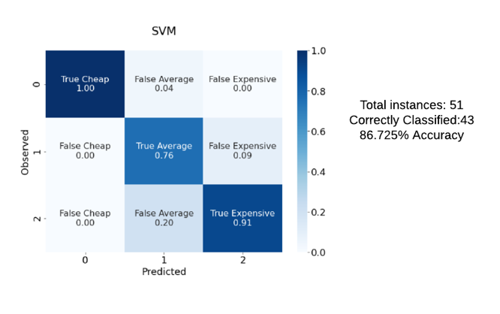
SVM Results
43 out of 51 correct predictions
100% precision on cheap cars & 93.75% recall
76% precision on average & 95% recall
91% precision on expensive & 66.6% recall
Notes:
The SVM model achieved the best accuracy, correctly predicting 43 instances (86.275%). It achieves 100% specificity on cheap cars and 93.75% sensitivity. 76% specificity on average prices and 95% sensitivity. 91% precision on expensive cars, but only 66.6% recall.

Slide 16
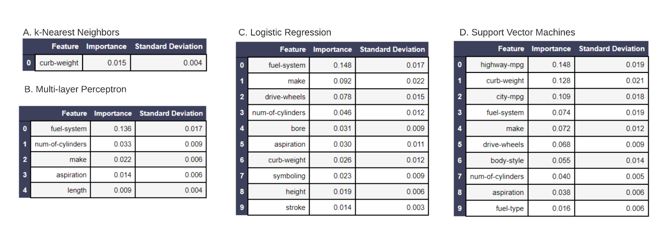
Sensitivity Analysis
A. kNN
C. Logistic Regression
SVM
B. ANN
Notes:
Sensitivity analysis, or feature importance, shows which individual variables have the strongest effect on the models. Even though there are similarities between the 4 algorithms, each one has picked on some different features.
The kNN algorithm used only curb weight. Lighter vehicles in this dataset must predominantly be minis and generally smaller, less expensive cars, while heavier ones are mostly executive or luxury automobiles.
The most important variable in the multi-layer perceptron classifier is the fuel system. As discussed in the variables analysis, more sophisticated fuel systems may be indicative of a newer, more technological advanced car. Since the ANN is achieving terrible precision the average price category, it won’t be used in aggregate sensitivity analysis.
The logistic regression model was able to utilise 10 variables. The most important one is the fuel system. The make, drive wheel distribution, number of cylinders and bore all play an important role. Nonetheless, features that were expected to of significant importance, such as horse power or engine size are absent.
SVM also picked up on 10 variables. Unlike the logistic regression, which uses features related to the engine, SVM picked up on fuel-related variables, such as miles per gas for both highway and city, as fuel as fuel type and fuel system.

Slide 17
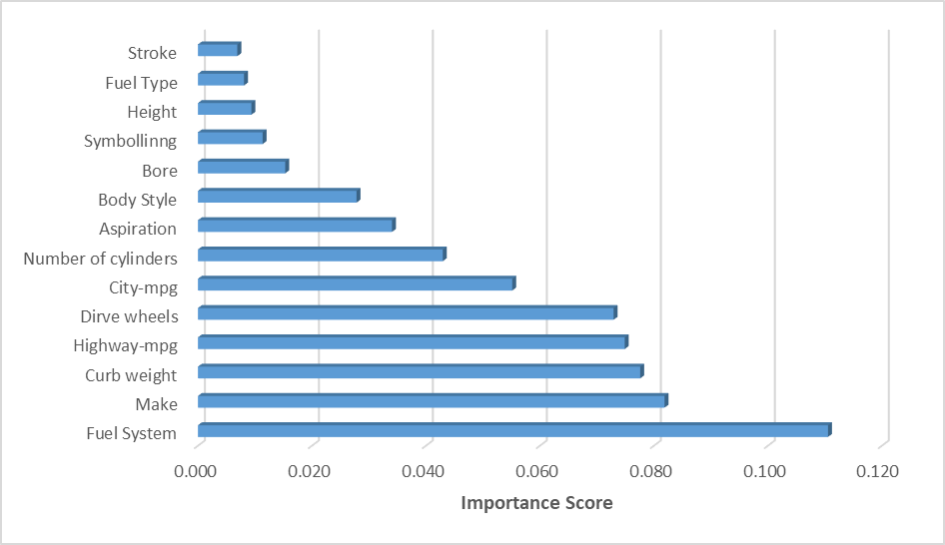
Aggregated Sensitivity Analysis
Fuel System most important
14 features
Notes:
A mixed sensitivity analysis is conducted between the Support Vector Machine and Logistic Regression models, with the purpose of improving general understanding of what the best automobile price indicators may be. The aggregated model is achieved by normalising the importance by the corresponding’s algorithm accuracy. Fuel system is clearly the most important feature, with a score >0.11, while the next 4 all lie between 0.07-0.085: make, curb weight, highway mpg, drive wheels.

Slide 18
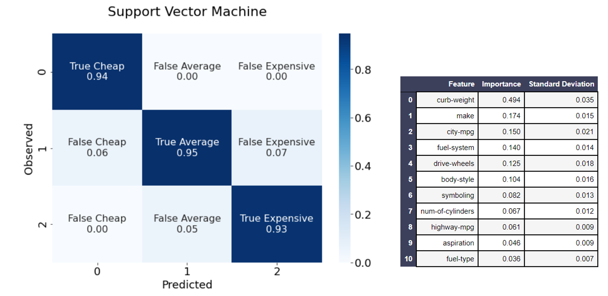
Best Model Performance and Features
A new model with the most important features
94.12% accuracy (48/51)
Curb weight by far most important feature
Notes:
By utilising only the relevant features in a new SVM model, a significantly better model is achieved, with 94.12% accuracy, predicting 48 out of the 51 samples correctly.
On cheap vehicles, it has 94% precision and 100% sensitivity.
On average prices, it achieves 95% precision and 90% sensitivity.
And on expensive cars, it has 93% precision and sensitivity.
Curb weight is by far the most important feature, with an importance score (0.494) more times greater than the runner up, make (0.174).

Slide 19
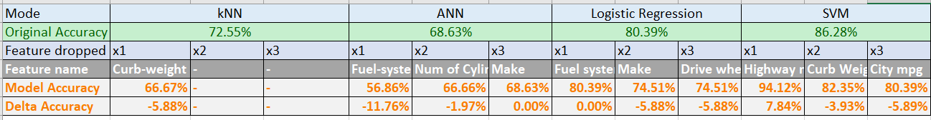
Models without important features
SVM model improved when removing the top feature.
ANN was worse or stayed the same
Logistic Regression was worse or stayed the same
kNN is worse after removing its feature
Notes:
The table shows the model’s performances without their top 3 features included. While artificial neural network and logistic regression faced a performance decline when top variables were dropped from the dataset, or at best remained the same, the SVM actually saw a significant improvement, by 7.84%, from 86.28% to 94.12%, when its most important feature, highway mpg was removed.
In both instances when curb weight was removed, a drop in performance was recorded.

Slide 20
Managerial Implications
Results are optimistic for car price prediction
Focusing on the 12 important variables is advised
The importance of curb-weight suggests the variable should be taken into account in future models
Engine specifications such as bore and stroke have also proven to be useful, and should be considered in favour of simple models that include only horsepower.
Notes:
The results of this report suggest that car price prediction is feasible, the best accuracy results being 94.12% on 3 categories. 14 important variables were identified, most of which are consistent with previous research. Focusing on these is advised in future decision making processes and machine learning models.
Moreover, the importance of curb-weight suggests the variable should be taken into account in future models. Engine specifications such as bore and stroke have also proven to be useful, and should be considered in favour of simple models that include only horsepower. Details about fuel type, system and consumption are also identified as relevant features that should be included in future analysis.
Management can leverage the results of this report in order to improve upon existing or upcoming second-hand automobile pricing decisions. Furthermore, the best model identified has the potential of aiding in odometer fraud detection, by identifying anomalies in predictions that include age vs those that do not.

Slide 21
Conclusions
Data mining was performed to design a model that predicts automobile prices.
CRISP-DM framework was utilised and explained.
kNN accuracy: 72.549%
ANN accuracy: 68.627%
Logistic Regression accuracy: 80.392%
SVM accuracy: 86.725%
Sensitivity analysis reveals fuel system as the most important feature
Improved SVM Model achieves 94.12%
Dropping highway mpg from the original SVM also led to 94.12% accuracy.
Further improvements:
More data
More variables
Ensemble machine learning models
Notes:
Data mining techniques were employed in order to predict automobile prices. For this purpose, the CRISP-DM framework was utilised and explained. Four machine learning models were used: k nearest neighbors, artificial neural networks, logistic regression and SVM, achieving 72.549%, 68.627%, 80.392% and 86.725% accuracy respectively. Sensitivity analysis revealed that fuel system was the most important feature, however an improved SVM model (94.12%) identified curb weight as the strongest price predictor. Nevertheless, such a strong prediction was also achieved when dropping highway mpg from the original SVM model’s features.
Further improvements could be made by utilising more data, more variables, and employing more complex ensemble machine learning models, which build on top of the ones discussed here.
Thank you for listening!

